Slide 1





WATER QUALITY PROJECT

Slide 2
ABOUT DATASET
Access to safe drinking-water is essential to health, a basic human right and a component of effective policy for health protection. This is important as a health and development issue at a national, regional and local level. In some regions, it has been shown that investments in water supply and sanitation can yield a net economic benefit, since the reductions in adverse health effects and health care costs outweigh the costs of undertaking the interventions.

Slide 3




FEATURE DESCRIPTION
PH value : PH is an important parameter in evaluating the acid–base balance of water. It is also the indicator of acidic or alkaline condition of water status. WHO has recommended maximum permissible limit of pH from 6.5 to 8.5. The current investigation ranges were 6.52–6.83 which are in the range of WHO standards. pH: pH is a measure of water's acidity or alkalinity, with a recommended range of 6.5 to 8.5 by WHO. The current study falls within this range at 6.52–6.83.

Slide 4
FEATURE DESCRIPTION
2. Hardness:
Hardness is mainly caused by calcium and magnesium salts. These salts are dissolved from geologic deposits through which water travels. The length of time water is in contact with hardness producing material helps determine how much hardness there is in raw water. Hardness was originally defined as the capacity of water to precipitate soap caused by Calcium and Magnesium.

Slide 5
FEATURE DESCRIPTION
3. Solids :
Water has the ability to dissolve a wide range of inorganic and some organic minerals or salts such as potassium, calcium, sodium, bicarbonates, chlorides, magnesium, sulfates etc. These minerals produced un-wanted taste and diluted color in appearance of water. This is the important parameter for the use of water. The water with high TDS value indicates that water is highly mineralized. Desirable limit for TDS is 500 mg/l and maximum limit is 1000 mg/l which prescribed for drinking purpose.

Slide 6
FEATURE DESCRIPTION
4. Chloramines :
Chlorine and chloramine are the major disinfectants used in public water systems. Chloramines are most commonly formed when ammonia is added to chlorine to treat drinking water. Chlorine levels up to 4 milligrams per liter (mg/L or 4 parts per million (ppm)) are considered safe in drinking water.

Slide 7
FEATURE DESCRIPTION
5. Sulfate :
Sulfates are naturally occurring substances that are found in minerals, soil, and rocks. They are present in ambient air, groundwater, plants, and food. The principal commercial use of sulfate is in the chemical industry. Sulfate concentration in seawater is about 2,700 milligrams per liter (mg/L). It ranges from 3 to 30 mg/L in most freshwater supplies, although much higher concentrations (1000 mg/L) are found in some geographic locations.

Slide 8
FEATURE DESCRIPTION
6. Conductivity :
Pure water is not a good conductor of electric current rather’s a good insulator. Increase in ions concentration enhances the electrical conductivity of water. Generally, the amount of dissolved solids in water determines the electrical conductivity. Electrical conductivity (EC) actually measures the ionic process of a solution that enables it to transmit current. According to WHO standards, EC value should not exceeded 400 μS/cm.

Slide 9
FEATURE DESCRIPTION
7. Organic carbon :
Total Organic Carbon (TOC) in source waters comes from decaying natural organic matter (NOM) as well as synthetic sources. TOC is a measure of the total amount of carbon in organic compounds in pure water. According to US EPA < 2 mg/L as TOC in treated / drinking water, and < 4 mg/Lit in source water which is use for treatment.

Slide 10
FEATURE DESCRIPTION
8. Trihalomethanes:
Pure THMs are chemicals which may be found in water treated with chlorine. The concentration of THMs in drinking water varies according to the level of organic material in the water, the amount of chlorine required to treat the water, and the temperature of the water that is being treated. THM levels up to 80 ppm is considered safe in drinking water.

Slide 11
FEATURE DESCRIPTION
9. Turbidity :
The turbidity of water depends on the quantity of solid matter present in the suspended state. It is a measure of light emitting properties of water and the test is used to indicate the quality of waste discharge with respect to colloidal matter. The mean turbidity value obtained for Wondo Genet Campus (0.98 NTU) is lower than the WHO recommended value of 5.00 NTU.

Slide 12
FEATURE DESCRIPTION
10. Potability :
Indicates if water is safe for human consumption where 1 means Potable and 0 means Not potable.

Slide 13

Data Engineering

Slide 14
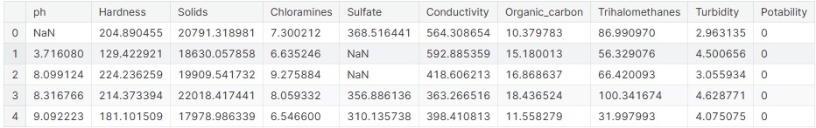
Load Data
#importation des données
water= pd.read_csv("water_potability.csv")
print("Columns in water DataFrame:", water.columns)
# Create a copy of the DataFrame
df = water.copy()
# Display the first few rows of the DataFrame
print("DataFrame `df`:")
print(df.head())

Slide 15
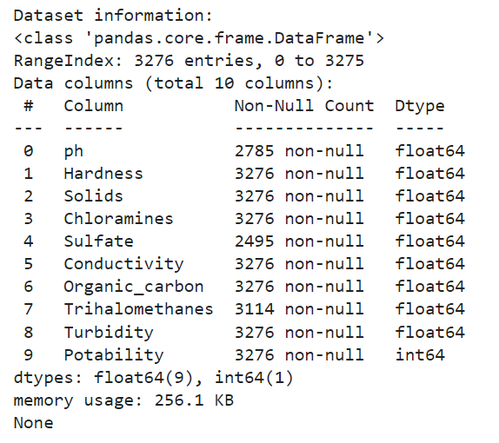
Data Exploration
# Display information about the dataset print("\n Dataset information:")
print(water.info())

Slide 16
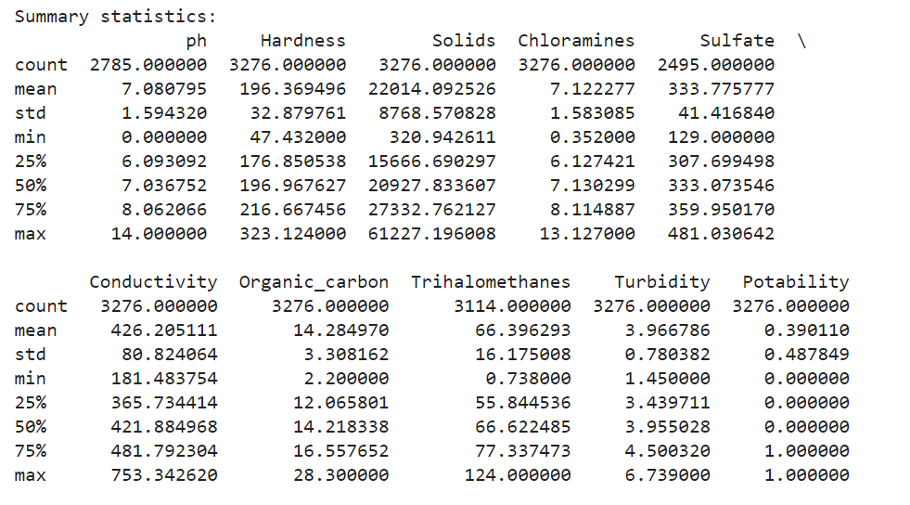
Data Exploration
# Summary statistics of numerical columns
print("\n Summary statistics:")
print(water.describe())

Slide 17
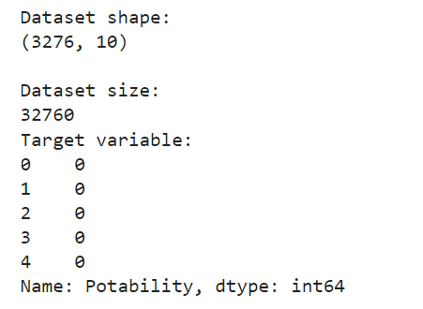
Data Exploration
print("\n Dataset shape:")
print(water.shape)
print("\n Dataset size:")
print(water.size)
# Extract the target variable if it exists
target = df['Potability']
print("Target variable:")
print(target.head())

Slide 18
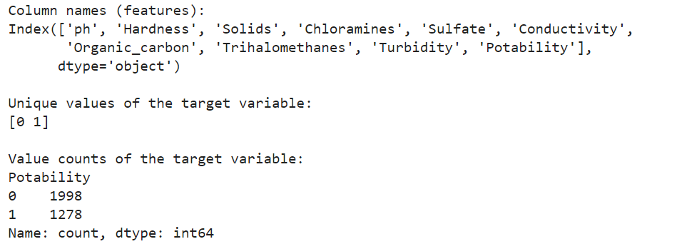
Data Exploration
# Display the column names (features)
print("\n Column names (features):")
print(water.columns)
# Assuming 'Potability' is the target variable
target_variable = 'Potability'
# Display unique values and value counts of the target variable
print("\n Unique values of the target variable:")
print(water[target_variable].unique())
# Value counts of the target variable
print("\n Value counts of the target variable:")
print(water[target_variable].value_counts())

Slide 19
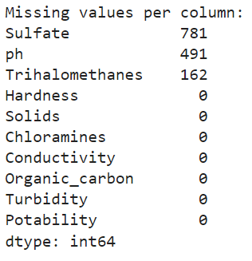
Data Exploration
# Checking for missing values
print("Missing values per column:")
print(water.isnull().sum().sort_values(ascending=False))

Slide 20
Data Exploration
# Filter numerical columns
numerical_columns=df.select_dtypes(include=['float64','int64']).columns
# Set the figure size
plt.figure(figsize=(12, 10))
# Create boxplots for each numerical column
for i, col in enumerate(numerical_columns):
plt.subplot(4, 4, i + 1) # Adjust subplot layout as needed
sns.boxplot(x=df[col])
plt.title(col)
plt.tight_layout() # Adjust layout spacing
plt.show()

Slide 21
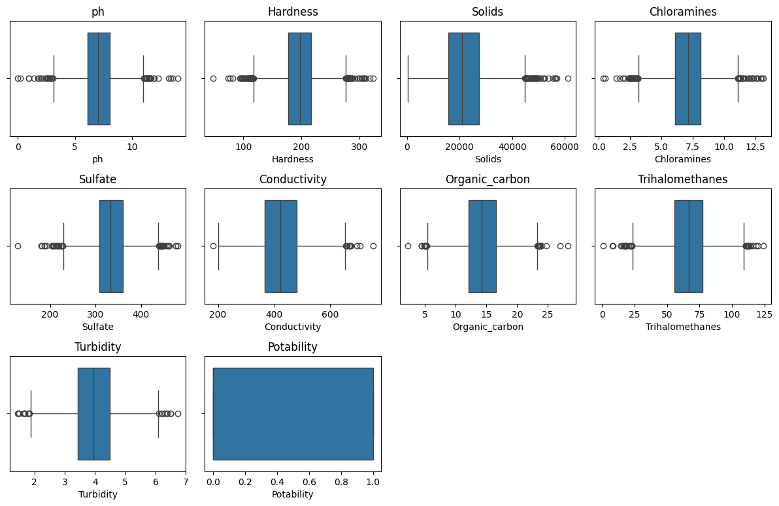
Data Exploration

Slide 22
Preprocessing
# Calculate conditional means for filling missing 'ph' values
condition_1_mean_ph = df[(df['Potability'] == 0) & (df['Hardness'] <= 150)]['ph'].mean()
condition_2_mean_ph = df[(df['Potability'] == 0) & (df['Hardness'] > 150)]['ph'].mean()
condition_3_mean_ph = df[(df['Potability'] == 1) & (df['Hardness'] <= 150)]['ph'].mean()
condition_4_mean_ph = df[(df['Potability'] == 1) & (df['Hardness'] > 150)]['ph'].mean()
# Print conditional means (for verification)
print("Mean pH Value for Potability=0 and Hardness<=150:", condition_1_mean_ph)
print("Mean pH Value for Potability=0 and Hardness>150:", condition_2_mean_ph)
print("Mean pH Value for Potability=1 and Hardness<=150:", condition_3_mean_ph)
print("Mean pH Value for Potability=1 and Hardness>150:", condition_4_mean_ph)

Slide 23
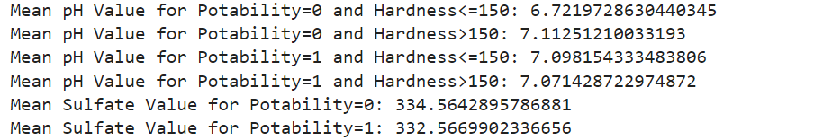
Preprocessing
# Iterate through the DataFrame to fill missing 'ph' values based on conditions
for idx, row in df.iterrows():
if pd.isnull(row['ph']): # Check if 'ph' value is missing
if row['Potability'] == 0 and row['Hardness'] <= 150:
df.at[idx, 'ph'] = condition_1_mean_ph
elif row['Potability'] == 0 and row['Hardness'] > 150:
df.at[idx, 'ph'] = condition_2_mean_ph
elif row['Potability'] == 1 and row['Hardness'] <= 150:
df.at[idx, 'ph'] = condition_3_mean_ph
elif row['Potability'] == 1 and row['Hardness'] > 150:
df.at[idx, 'ph'] = condition_4_mean_ph

Slide 24
Preprocessing
# Calculate conditional mean Sulfate values
condition_1_mean_sulfate = df[df['Potability'] == 0]['Sulfate'].mean()
condition_2_mean_sulfate = df[df['Potability'] == 1]['Sulfate'].mean()
# Print conditional means (for verification)
print("Mean Sulfate Value for Potability=0:",condition_1_mean_sulfate)
print("Mean Sulfate Value for Potability=1:",condition_2_mean_sulfate)

Slide 25
Preprocessing
# Iterate through the DataFrame to fill missing 'Sulfate' values
for idx, row in df.iterrows():
if pd.isnull(row['Sulfate']): # Check if 'Sulfate' value is missing
if row['Potability'] == 0:
df.at[idx, 'Sulfate'] = condition_1_mean_sulfate
elif row['Potability'] == 1:
df.at[idx, 'Sulfate'] = condition_2_mean_sulfate
#Trihalomethanes
df['Trihalomethanes'].fillna(value = df['Trihalomethanes'].mean() , inplace = True)
# Check for missing values after filling
print("Missing values per column:")
print(df.isnull().sum().sort_values(ascending=False))
# Check for duplicated rows
duplicates = df[df.duplicated()]

Slide 26
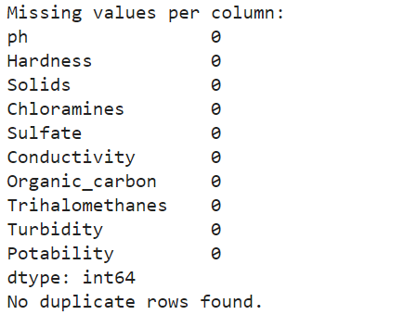
Preprocessing
# Display duplicated rows (if any)
if not duplicates.empty:
print("Duplicate Rows:")
print(duplicates)
else:
print("No duplicate rows found.")

Slide 27
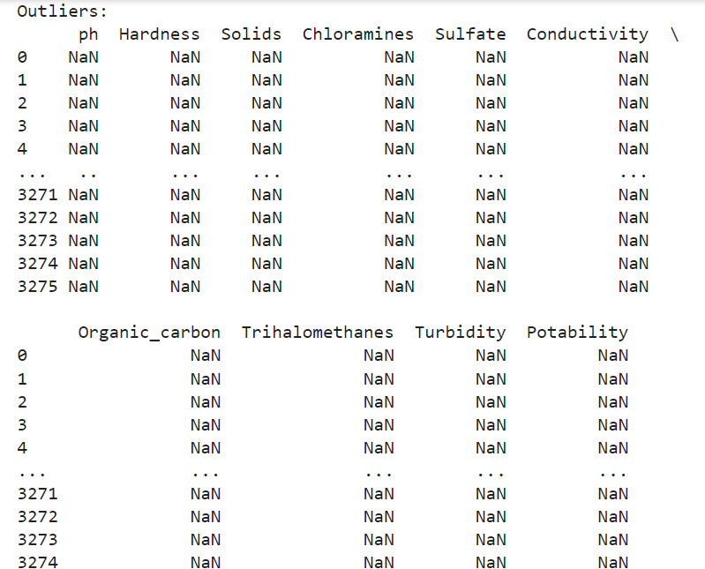
Preprocessing
# Calculate z-scores for each numeric column
z_scores = np.abs((df - df.mean()) / df.std())
# Define threshold for outlier detection (e.g., z-score > 3)
outlier_threshold = 3
outliers = df[z_scores > outlier_threshold]
# Visualize outliers or inspect using descriptive statistics
print("Outliers:")
print(outliers)

Slide 28
Preprocessing
# Remove outliers based on z-scores
cleaned_df = df[(z_scores <= outlier_threshold).all(axis=1)]
# Set the figure size
plt.figure(figsize=(12, 10))
# Create boxplots for each numerical column
for i, col in enumerate(numerical_columns):
plt.subplot(4, 4, i + 1) # Adjust subplot layout as needed
sns.boxplot(x=df[col])
plt.title(col)
plt.tight_layout() # Adjust layout spacing
plt.show()

Slide 29
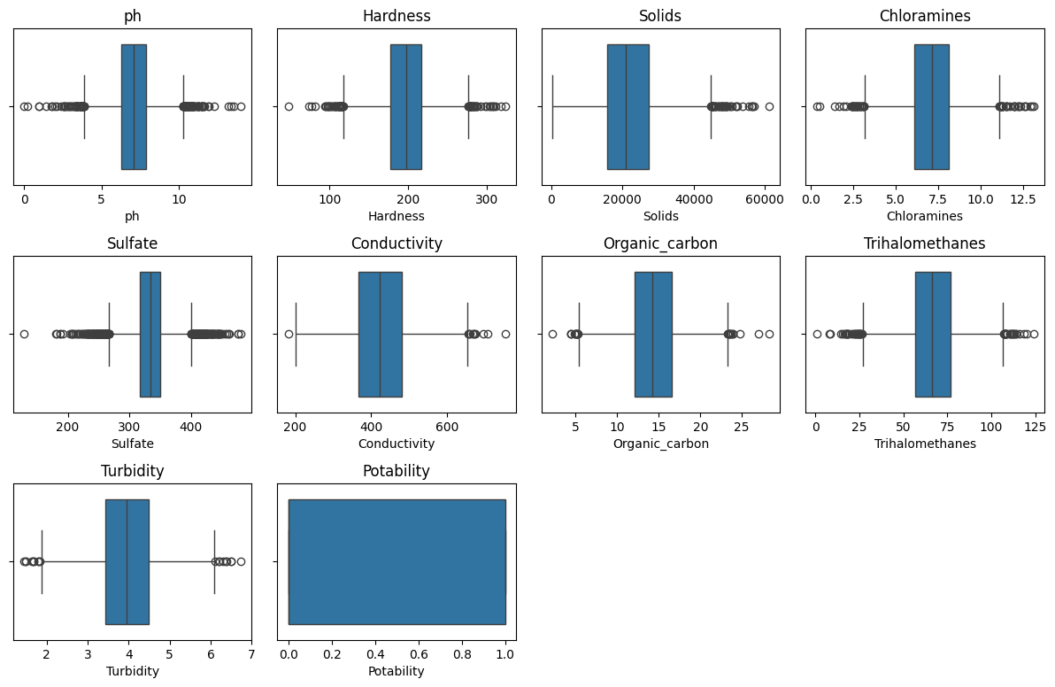
Preprocessing

Slide 30
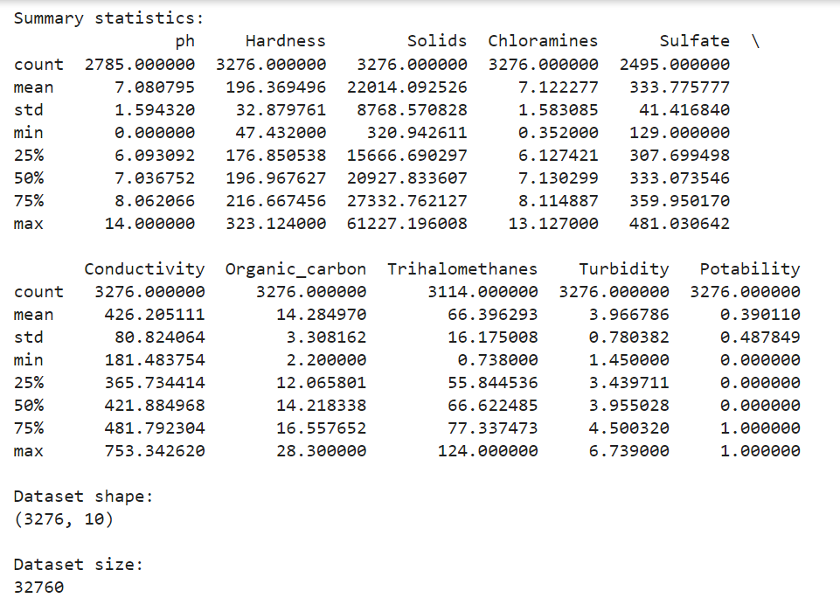
After Preprocessing
# Summary statistics of numerical columns
print("\n Summary statistics:")
print(water.describe())
print("\n Dataset shape:")
print(water.shape)
print("\n Dataset size:")
print(water.size)

Slide 31
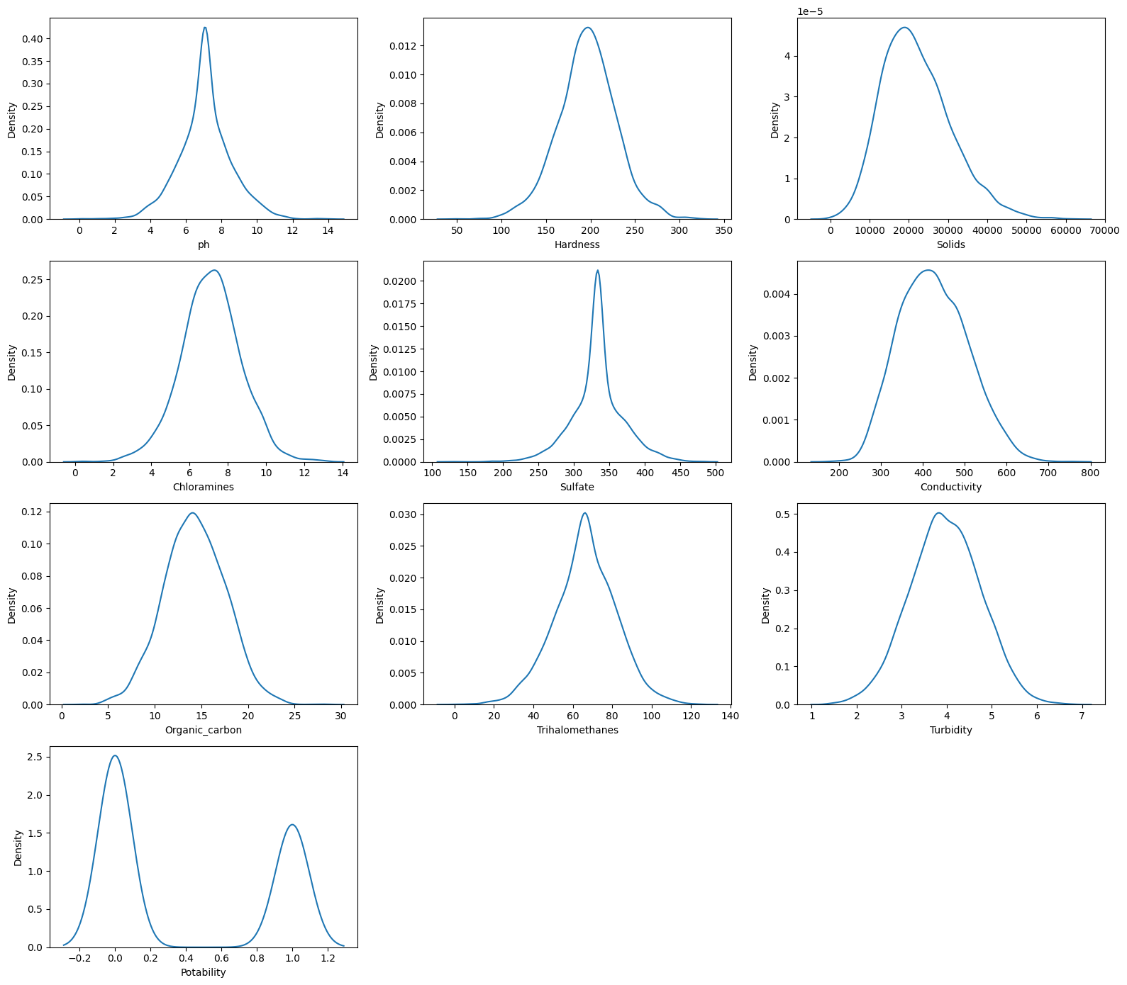
After Preprocessing

Slide 32
After Preprocessing
#sns.pairplot(df,hue='Potability')
sns.set(rc={'figure.figsize':(60,50)})
plt.figure(figsize=(10,10))
Heated = sns.heatmap(df.corr("pearson"),vmin=-1, vmax=1,cmap='viridis',annot=True, square=True)
Heated.set(xlabel = "Pearson Correlation Coefficient Heatmap")

Slide 33
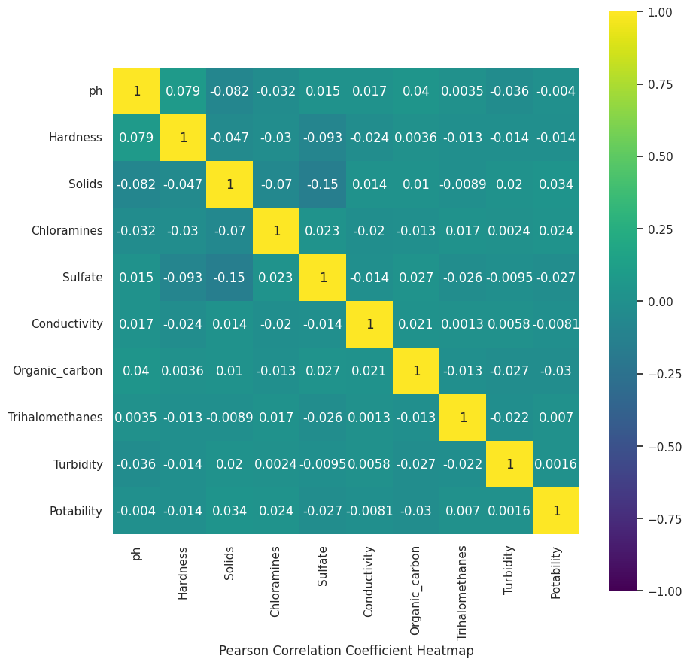
After Preprocessing

Slide 34
After Preprocessing
#box plots
fig, ax = plt.subplots(10, 1, figsize=(10, 20))
fig.subplots_adjust(hspace=0.75)
for i in range(10) :
# Ax
sns.boxplot(x=df.columns[i], data=df, ax=ax[i])

Slide 35
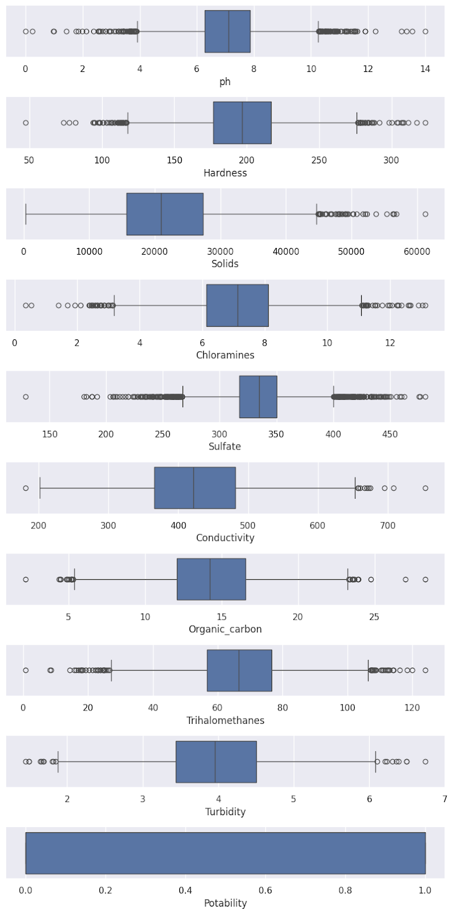

Slide 36
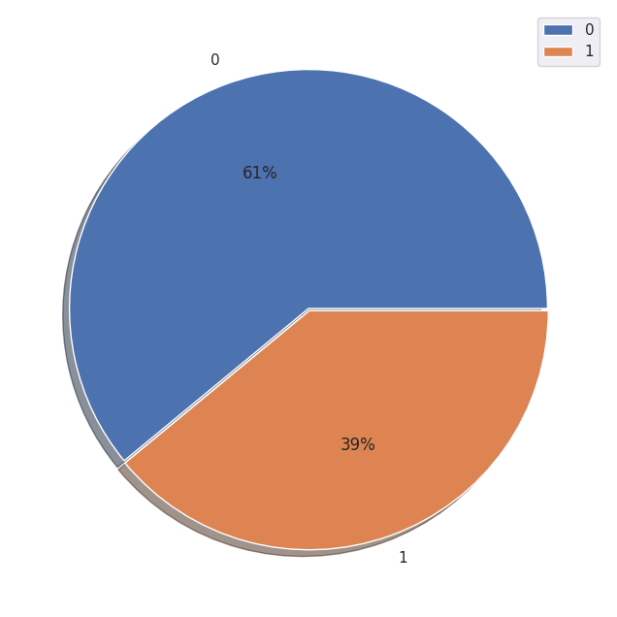
After Preprocessing
#Potability
tar = df['Potability'].value_counts()
print(tar)
plt.figure(figsize=(8,8))
plt.pie(tar, labels=[0, 1], explode=[0, 0.01], autopct='%.f%%', shadow=True)
plt.legend()
plt.show()

Slide 37

Model Engineering

Slide 38
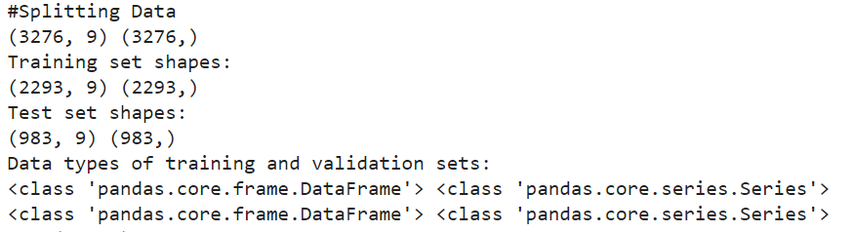
Splitting Data
#Splitting Data
#Split dataset into training set and test set
print("#Splitting Data")
x = df.iloc[:,:9]
y = df["Potability"]
print(x.shape,y.shape)
x_train, x_test, y_train, y_test = train_test_split(x, y, test_size=0.3, random_state=42)
print("Training set shapes:")
print(x_train.shape, y_train.shape)
print("Test set shapes:")
print(x_test.shape, y_test.shape)
print("Data types of training and validation sets:")
print(type(x_train), type(y_train))
print(type(x_test), type(y_test))

Slide 39
Decision Tree
#Building Decision Tree Model
#Create Decision Tree Classifier object
treeClassifier = DecisionTreeClassifier()
#Train Decision Tree Classifier
dtree = treeClassifier.fit(x_train,y_train)
print("type(dtree)")
print(type(dtree))
print("dir(dtree)")
print(dir(dtree))

Slide 40
Decision Tree
from sklearn.tree import plot_tree
# Plot the entire tree
plt.figure(figsize=(20, 20))
plot_tree(treeClassifier, filled=True, fontsize=10)
plt.show()

Slide 41
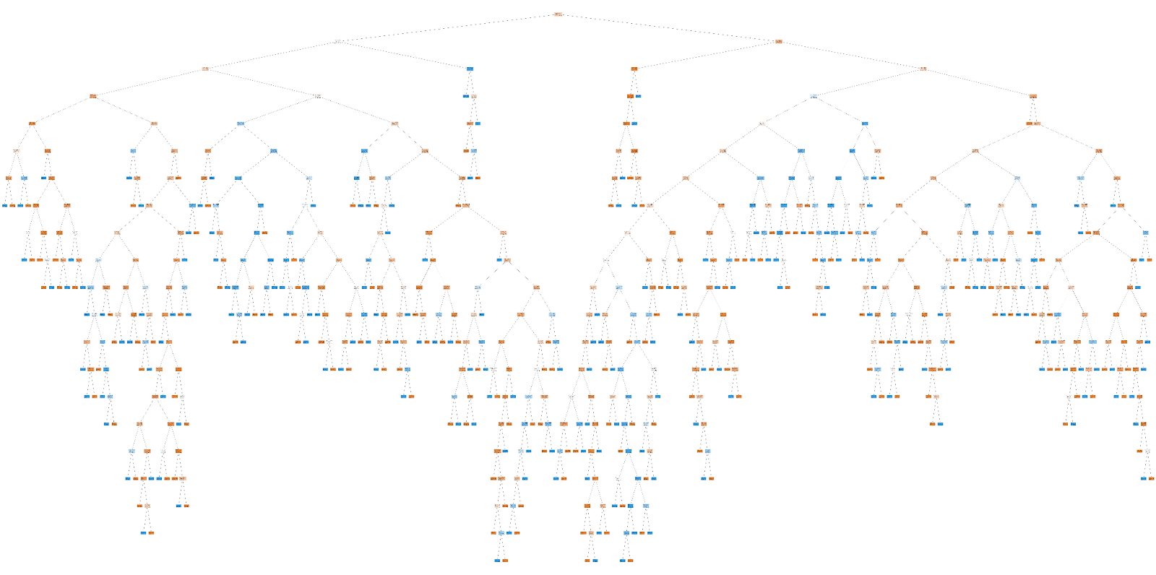
Decision Tree

Slide 42
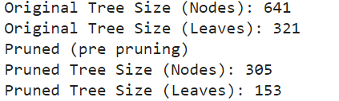
Unpruned tree vs Pruned tree
# Size of the original tree
original_tree_size = dtree.tree_.node_count
original_tree_leaves = dtree.tree_.n_leaves
# Size of the pruned tree
pruned_tree_size = final_model.tree_.node_count
pruned_tree_leaves = final_model.tree_.n_leaves
print("Original Tree Size (Nodes):", original_tree_size)
print("Original Tree Size (Leaves):", original_tree_leaves)
print("Pruned (pre pruning)")
print("Pruned Tree Size (Nodes):", pruned_tree_size)
print("Pruned Tree Size (Leaves):", pruned_tree_leaves)

Slide 43
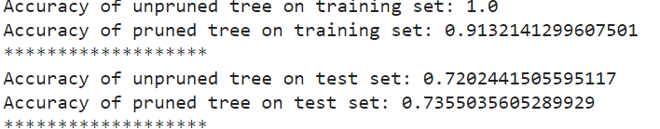
Unpruned tree vs Pruned tree
from sklearn.metrics import accuracy_score
# Predictions on the training set
y_train_pred_unpruned = treeClassifier.predict(x_train)
y_train_pred_pruned = final_model.predict(x_train)
# Predictions on the test set
y_test_pred_unpruned = treeClassifier.predict(x_test)
y_test_pred_pruned = final_model.predict(x_test)
# Compute accuracies
accuracy_train_unpruned = accuracy_score(y_train, y_train_pred_unpruned)
accuracy_train_pruned = accuracy_score(y_train, y_train_pred_pruned)
accuracy_test_unpruned = accuracy_score(y_test, y_test_pred_unpruned)
accuracy_test_pruned = accuracy_score(y_test, y_test_pred_pruned)
print("Accuracy of unpruned tree on training set:", accuracy_train_unpruned)
print("Accuracy of pruned tree on training set:", accuracy_train_pruned)
print("*******************")
print("Accuracy of unpruned tree on test set:", accuracy_test_unpruned)
print("Accuracy of pruned tree on test set:", accuracy_test_pruned)

Slide 44
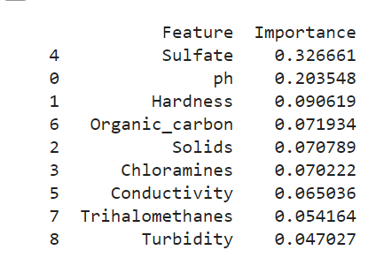
Most relevant features for the classification task
Here's how to interpret feature importance:
High Importance: A feature with high importance indicates that it plays a significant role in the decision-making process of the model. It has a strong influence on predicting the target variable.
Low Importance: A feature with low importance has less impact on the model's decision-making process and may not contribute much to predicting the target variable.
In our Data Set Sulfate, ph, and Hardness are the top three most relevant features for predicting water potability based on their importance scores.

Slide 45
Unpruned tree vs Pruned tree
#Q.I
# Size of the original tree
original_tree_size = dtree.tree_.node_count
original_tree_leaves = dtree.tree_.n_leaves
# Size of the pruned tree
pruned_tree_size = final_model.tree_.node_count
pruned_tree_leaves = final_model.tree_.n_leaves
print("Original Tree Size (Nodes):", original_tree_size)
print("Original Tree Size (Leaves):", original_tree_leaves)
print("Pruned (pre pruning)")
print("Pruned Tree Size (Nodes):", pruned_tree_size)
print("Pruned Tree Size (Leaves):", pruned_tree_leaves)

Slide 46
Unpruned tree vs Pruned tree

Slide 47
Post Pruning
# Further split the data into training, validation
x_train, x_val, y_train, y_val = train_test_split(x_train, y_train, test_size=0.2, random_state=42)
# Train the decision tree on the training set
tree = DecisionTreeClassifier(random_state=42)
tree.fit(x_train, y_train)
# Evaluate the initial tree on the validation set
initial_val_accuracy = accuracy_score(y_val, tree.predict(x_val))
print("Initial Validation Accuracy:", initial_val_accuracy)
# Prune the tree using Cost Complexity Pruning (CCP)
path = tree.cost_complexity_pruning_path(x_train, y_train)
ccp_alphas, impurities = path.ccp_alphas[:-1], path.impurities[:-1]
pruned_trees = []
for ccp_alpha in ccp_alphas:
pruned_tree = DecisionTreeClassifier(ccp_alpha=ccp_alpha, random_state=42)
pruned_tree.fit(x_train, y_train)
pruned_trees.append(pruned_tree)
# Find the pruned tree with the best validation accuracy
best_tree = None
best_val_accuracy = initial_val_accuracy
for tree in pruned_trees:
val_accuracy = accuracy_score(y_val, tree.predict(x_val))
if val_accuracy > best_val_accuracy:
best_val_accuracy = val_accuracy
best_tree = tree
# Evaluate the best pruned tree on the test set
if best_tree:
pruned_tree_accuracy = accuracy_score(y_test, best_tree.predict(x_test))
print("Accuracy of the pruned tree on the test set:", pruned_tree_accuracy)
else:
print("No pruned tree selected.")

Slide 48
Post Pruning

Slide 49
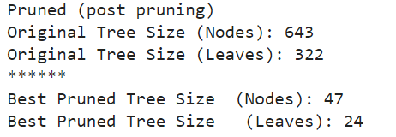
Unpruned tree vs Pruned tree
#Q.L
# Size of the original tree
original_tree_size = dtree.tree_.node_count
original_tree_leaves = dtree.tree_.n_leaves
# Size of the pruned tree
pruned_tree_size2 = best_tree.tree_.node_count
pruned_tree_leaves2 = best_tree.tree_.n_leaves
print("Pruned (post pruning)")
print("Original Tree Size (Nodes):", original_tree_size)
print("Original Tree Size (Leaves):", original_tree_leaves)
print("******")
print("Best Pruned Tree Size (Nodes):", pruned_tree_size2)
print("Best Pruned Tree Size (Leaves):", pruned_tree_leaves2)

Slide 50
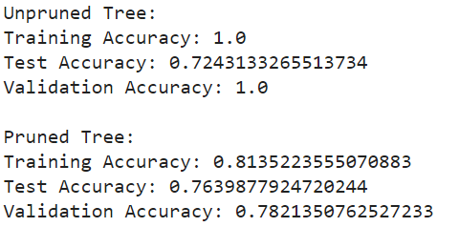
Unpruned tree vs Pruned tree
train_accuracy_unpruned = accuracy_score(y_train, treeClassifier.predict(x_train))
test_accuracy_unpruned = accuracy_score(y_test, treeClassifier.predict(x_test))
val_accuracy_unpruned = accuracy_score(y_val, treeClassifier.predict(x_val))
# Pruned tree accuracies
if best_tree :
train_accuracy_pruned = accuracy_score(y_train, best_tree.predict(x_train))
test_accuracy_pruned = accuracy_score(y_test, best_tree.predict(x_test))
val_accuracy_pruned = accuracy_score(y_val, best_tree.predict(x_val))
else:
train_accuracy_pruned = None
test_accuracy_pruned = None
val_accuracy_pruned = None
# Print the accuracies
print("Unpruned Tree:")
print("Training Accuracy:", train_accuracy_unpruned)
print("Test Accuracy:", test_accuracy_unpruned)
print("Validation Accuracy:", val_accuracy_unpruned)
if best_tree:
print("\n Pruned Tree:")
print("Training Accuracy:", train_accuracy_pruned)
print("Test Accuracy:", test_accuracy_pruned)
print("Validation Accuracy:", val_accuracy_pruned)
else:
print("\n No pruned tree selected.")

Slide 51
Unpruned vs Pruned Trees
Unpruned:
Accuracy of unpruned tree on training set: 1.0
Accuracy of unpruned tree on test set: 0.7212614445574771
Validation Accuracy: 1.0
Pruned (pre pruning)
Accuracy of pruned tree on training set: 0.8962058438726559
Accuracy of pruned tree on test set: 0.7385554425228891
Initial Validation Accuracy: 0.7320261437908496
Accuracy of the pruned tree on the test set: 0.7639877924720244
Pruned (post pruning)
Training Accuracy: 0.8135223555070883
Test Accuracy: 0.7639877924720244
Validation Accuracy: 0.7821350762527233
The unpruned tree shows a perfect training accuracy (1.0), but it has lower test accuracy (0.7213), suggesting overfitting.
In contrast, the pruned tree has a slightly lower training accuracy (0.8135), indicating better generalization, and it performs better on the test set (accuracy of 0.764).
Based on these results, we would recommend using the pruned tree for future data classification because it generalizes better and achieves higher accuracy on unseen data compared to the unpruned tree. The pruned tree strikes a good balance between training and test performance, making it more reliable for practical use.

Slide 52
Unpruned vs Pruned Trees
The post-pruned tree shows better generalization with higher test accuracy (0.7639) and validation accuracy (0.7821) compared to the pre-pruned tree (test accuracy of 0.7386 and initial validation accuracy of 0.7320).
Despite having a lower training accuracy (0.8135 vs. 0.8962), the post-pruned tree is less likely to overfit and can make reliable predictions on new data.
Based on these results, we recommend using the post-pruned tree for future data classification because it demonstrates improved generalization and performance across different datasets compared to the pre-pruned tree.

Slide 53
Combining pre-pruning and post-pruning ?
Pre-Pruning Only:
Test Accuracy with pre-pruning: 0.7386
Post-Pruning Only:
Test Accuracy with post-pruning: 0.7639
Combined Pre-Pruning and Post-Pruning:
Test Accuracy after combining both approaches: 0.7711
Post-pruning alone resulted in a test accuracy of 0.7639, which was higher than the accuracy achieved with pre-pruning alone (0.7386), demonstrating the effectiveness of post-pruning in refining the model.
When combining pre-pruning with post-pruning, the test accuracy further improved to 0.7711, showing a modest enhancement over post-pruning alone.
In conclusion post-pruning significantly improved the model's test accuracy compared to pre-pruning alone.
Combining pre-pruning and post-pruning yielded a slightly higher test accuracy, indicating the benefits of both approaches in optimizing the decision tree model.
This revised evaluation emphasizes the positive impact of post-pruning on model performance and the potential modest gains achieved by combining pre-pruning with post-pruning strategies.

Slide 54


THANK YOU FOR LISTENING!
Reach out for any questions.
Presentation by
Samar Mestiri
Khawla Grissa
Malak Elftaief

